Slide 1
RateStats
From Manual Collection → Python Automation → AI Search
Xu Wenzhe
Bank of China Singapore Branch · Financial Technology Department
NUS-ISS Industrial Attachment Presentation

Slide 2
Agenda
• Project Background
• My Project Role
• Development Phases — Requirements → Design → Implementation → Testing → Deployment
• Project Status
• Business Value & Value Added by Intern
RateStats | Bank of China Singapore | Xu Wenzhe
2

Slide 3
Project Background
How the project evolved
• Business need: collect deposit / promo rates across ~17 Singapore banks (~47 rate nodes)
• Stage 0 — Fully manual: staff open bank sites, copy rates, maintain Excel by hand
• Stage 1 — Python app I built: fetch / parse / generate MarketRateData + Rainbow Excel
• (URLs still fed manually via url_params.xlsx — fragile when banks reconstruct their website)
• Stage 2 — Add AI Search into that pipeline: discover URLs → validate → reuse existing parsers
• Constraint: controlled AI (search + scoring) — not unrestricted cloud LLM agents
RateStats | Bank of China Singapore | Xu Wenzhe
3

Slide 4
My Project Role
Built the Python product first · then added AI Search
• Started as Python developer: turn a manual rate-collection job into a working application
• Built extractors (HTML / PDF / API) and Excel outputs business users actually run
• Then extended the same pipeline with AI URL discovery (Vertex + provider benchmarks)
• Added hybrid URL selection: domain rules + ML ranker when AI candidates are ambiguous
• Packaged batch runs, URL health checks, scheduled output under runs/YYYYMMDD/
• Also supported RPA ops bots — today’s focus is RateStats only
RateStats | Bank of China Singapore | Xu Wenzhe
4

Slide 5
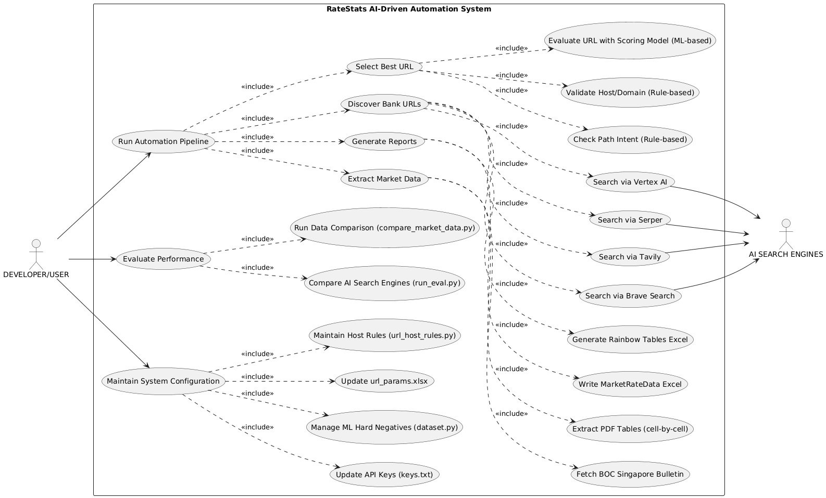
Development Phases — Requirements & Design
Python foundation → AI extension
• Phase A (Python): automate fetch + parse + Excel — replace hand-copying of rates
• Phase A still needed: reliable bank parsers (HTML DOM, PDF tables, JSON APIs)
• Phase B (AI): stop hand-feeding every URL — search latest pages per destination
• Phase B also: reject wrong links (wrong bank / Premier vs board / PDF vs HTML)
• Final design: AI Discovery + Scoring plugged into the existing Extract & Output engine
• Scenario: ICBC needs SGD board/promo + FCY board/promo — same pattern × ~17 banks
RateStats | Bank of China Singapore | Xu Wenzhe
5

Slide 6
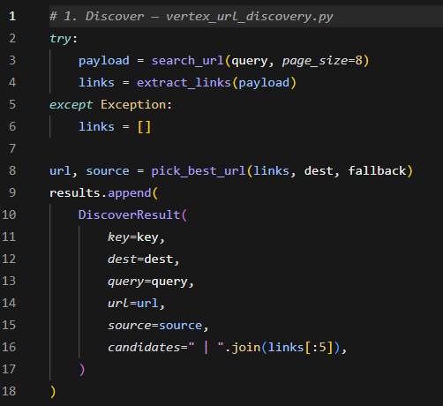
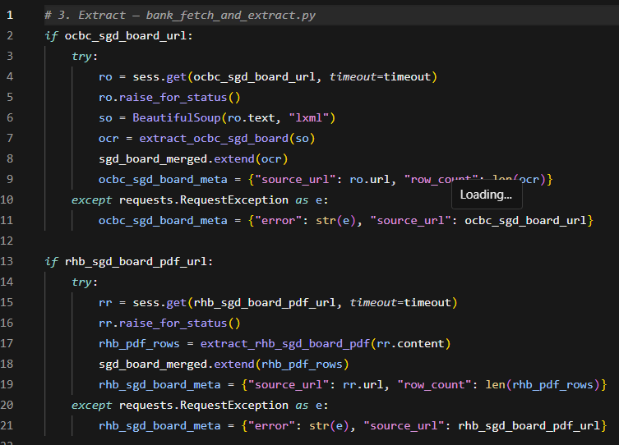
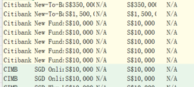
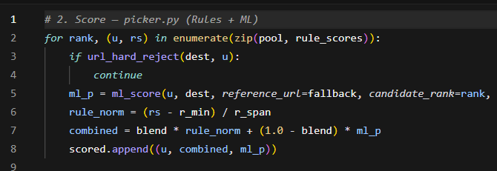
Implementation — End-to-End Architecture
AI Search added on top of the Python extract/output I built first
1. Discover
AI Search*
candidate URLs
2. Score
Rules + ML
host whitelist
3. Extract*
HTML / PDF / API
Python parsers
4. Output*
MarketRateData
+ Rainbow Excel
→
→
→
• * Steps 3–4 existed first as a Python application; Steps 1–2 were added later
RateStats | Bank of China Singapore | Xu Wenzhe
6

Slide 7
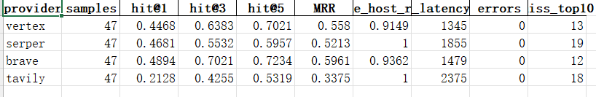
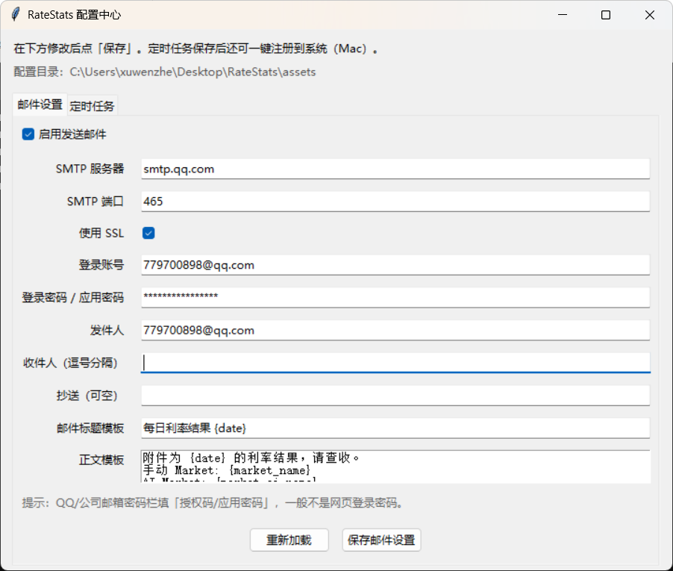
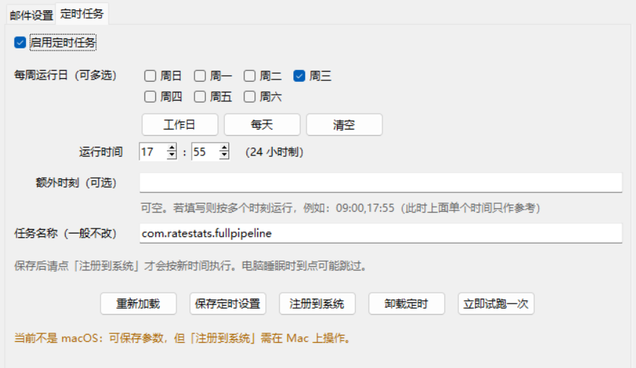

Testing & Deployment
How we know it works · how it runs
• Testing: compare AI-picked URLs vs manual golden urls in url_params.xlsx
• Testing: picker_eval reports · multi-provider benchmark (Vertex / Serper / Brave / Tavily)
• Testing: URL health checks (status / redirect) before scheduled runs
• Deployment: batch scripts + Windows Task Scheduler → dated runs/YYYYMMDD/
• Deliverables: MarketRateData_*.xlsx + Rainbow Table Excel for business users
AI search engine compare
URL health check
Task scheduler(email&run time)
RateStats | Bank of China Singapore | Xu Wenzhe
7

Slide 8
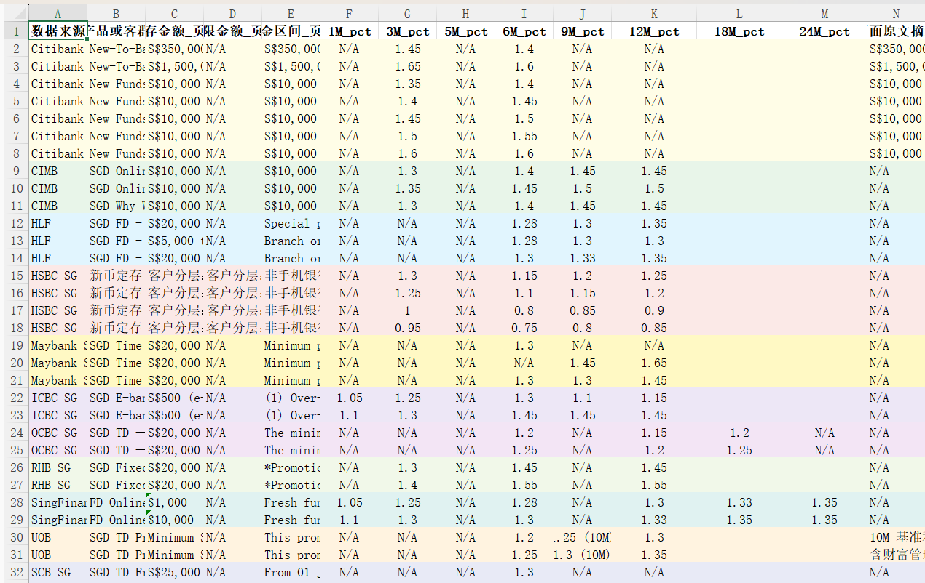
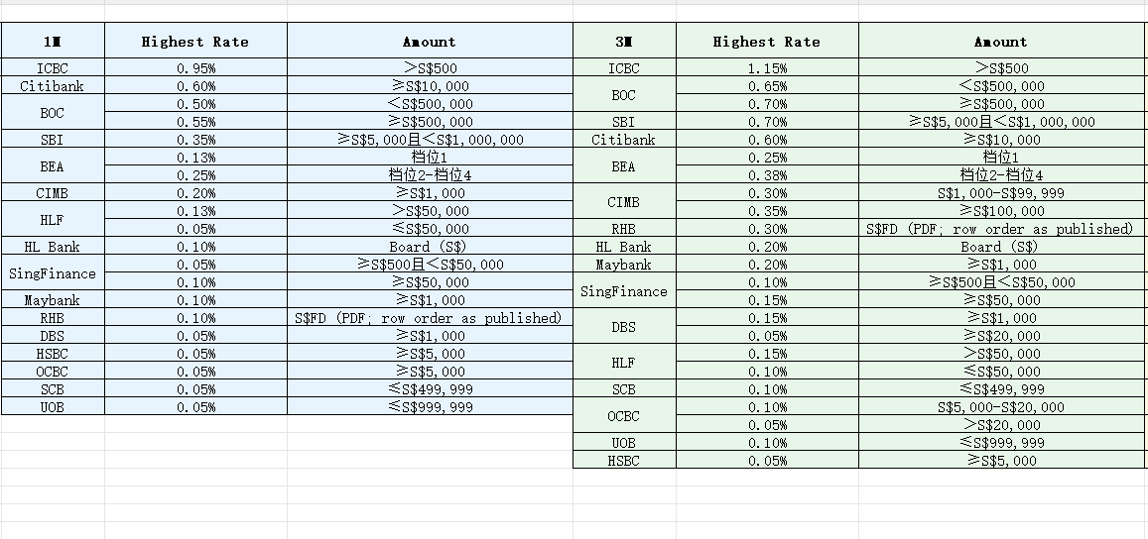
Result
RateData-From website
Rainbow Table-From RateData
RateStats | Bank of China Singapore | Xu Wenzhe
11

Slide 9
Project Status
C = Completed · I = In progress
• Python extraction (HTML / PDF / API) — Production (C) [built first]
• Batch pipeline + Excel (MarketRateData / Rainbow) — Production (C)
• AI URL Discovery (Vertex) — Production (C) [added into the flow]
• Rule-based scoring & host validation — Production (C)
• Multi-AI benchmarking module — Production (C)
• ML hybrid URL ranker — Integration done; production tuning ongoing (I)
RateStats | Bank of China Singapore | Xu Wenzhe
8

Slide 10
Business Value — Before vs After
Emphasize tangible outcomes
BEFORE (Manual)
• Fully manual: open sites, copy rates
• Heavy manpower on ~47 rate nodes
• Easy to miss updates / typos
• No reusable application pipeline
• Needs about an hour to collect and make Excel
AFTER (Python + AI)
• The first AI project in BOC
• Python app: fetch / parse → Excel
• AI Search finds URLs; rules/ML check
• Scheduled runs; fewer missing rows
• ~95% URL hit, just need to check the wrong links
• Only 5 mins for running the script and 15 mins for checking
RateStats | Bank of China Singapore | Xu Wenzhe
9

Slide 11
Value of the Intern
• Delivered a usable Python product first — not only a research prototype
• Grew it from scripts to a schedulable application business users can run
• Then plugged AI Search into that real pipeline (not a separate demo)
• Designed hybrid rules + ML when pure AI candidates were wrong
• Some mistakes are made with the change of standard of deposits, which causes some problems about the data fetch, and still need to be fixed
RateStats | Bank of China Singapore | Xu Wenzhe
10

Slide 12
Conclusion
• Journey: fully manual → Python automation (extract/Excel) → AI Search in the same flow
• AI is an extension of a working application — not the starting point
• Hybrid Rules + ML keeps URL accuracy high (~95%) under bank security constraints
• The data hitting is about 90%, the fault mainly comes from the wrong URL choosing, some of them comes from the change of standard of deposits.
• Business impact: less manpower, more reliable market-rate Excel
Thanks!
RateStats | Bank of China Singapore | Xu Wenzhe
12

Slide 13
Q&A
Thanks!
RateStats | Bank of China Singapore | Xu Wenzhe
13

